Slide 1
Denver Crime Prediction
By: Matthew McFall

Slide 2
Overview
Dataset Overview
Cleaning the Data
KNN Model
Issues Using KNN
DBSCAN Model
Hotspot Analysis
Alternative Model
Conclusion

Slide 3
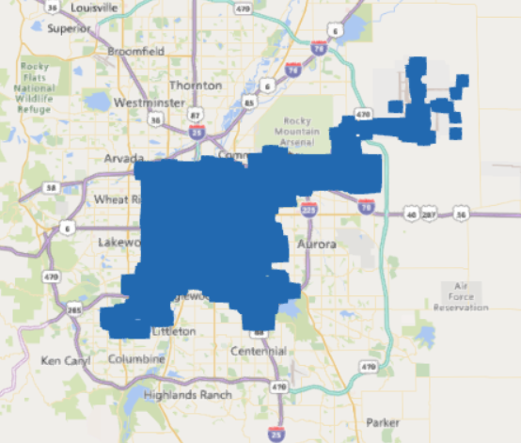
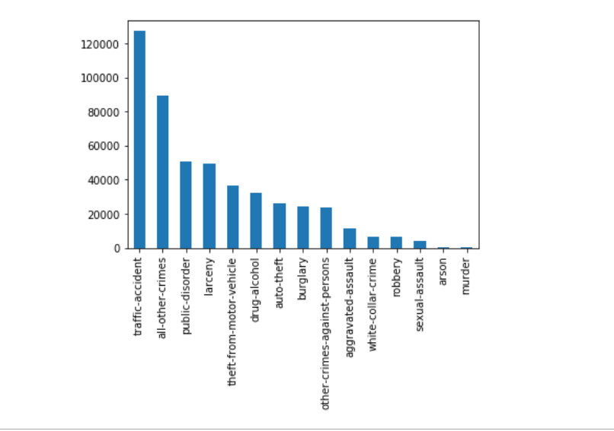
Dataset Overview
Length:493k after cleaning:483k
Width: 19 after cleaning: 3-4
Missing Values: Sexual Assault
Data Time Frame: passed 5 years plus the current

Slide 4
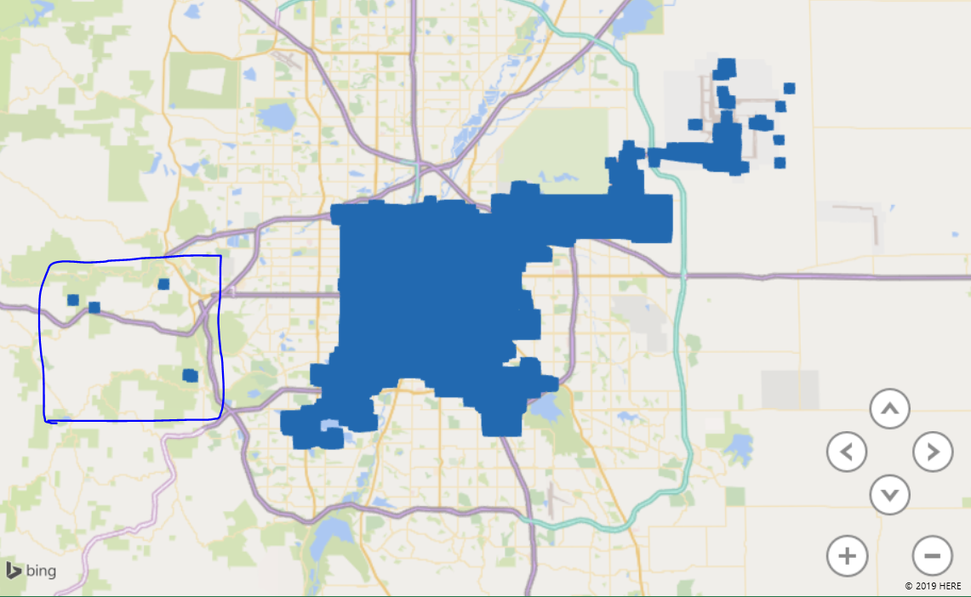
Cleaning the Data

Slide 5
KNN Model

Slide 6
Issues with using KNN

Slide 7
DBSCAN Model

Slide 8
Conclusion
Lessions learned

Slide 11
Thank You!

Slide 12
References

